Slide 1

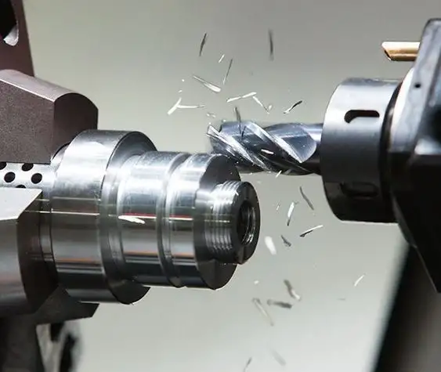
Predictive Maintenance Dataset
Group 11
Members:
Aniket Sakharkar
Mayur Mahanta
Jwalit Shah
Dev Patel

Slide 2

Table Of Contents
Introduction
Data Description & Source Link
Data Features
Exploratory Data Analysis (EDA)
Feature Engineering & EDA
Model Implementation
Performance Evaluation
Conclusion
References

Slide 3
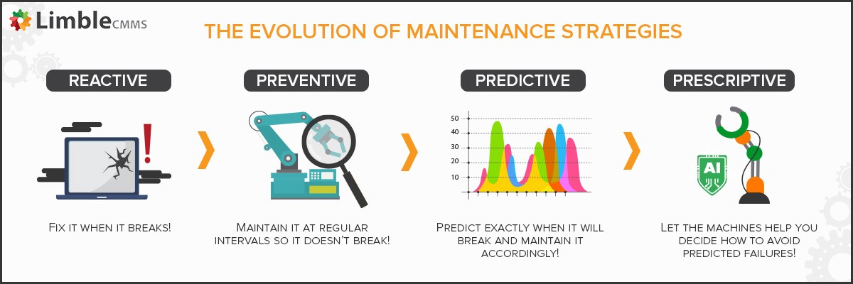

INTRODUCTION
The world has been at the forefront of development in Industrialization and modernization for the past two decades.
Industries involved in production comprise of power plants which are loaded with heavy machinery. Their extensive and continuous use makes it imperative for a timely scheduling of maintenance activities for these machines.
There are numerous maintenance techniques used of which predictive maintenance is one which schedules maintenance at the most cost efficient and convenient moment, allowing the equipment's lifespan to be optimized to its fullest before it gets compromised.
Early on, it was difficult to implement Predictive Maintenance due to a lack of sensors to generate data and computational resources to gather and analyse data. Since the advent of technology, these sensors gather data and store in the system based on which the maintenance activities are scheduled.
The dataset shows five main factors like Air temperature, Process temperature, torque, tool wear and Rotational speed which can lead to a machine failure. It also shows five types of failures which eventually lead to machine failure.
Aim :- To classify if a given machine is likely to fail or not based on a certain set of values of the features. This prediction allows timely scheduling of maintenance activities at a certain point in future.

Slide 4
Data Description & Source Link
The Predictive Maintenance Dataset is from the UCI ML website.
The dataset consist of 10 k datapoints and 14 features.
UCI Machine Learning Repository: AI4I 2020 Predictive Maintenance Dataset Data Set
It is a synthetic dataset that reflects real predictive maintenance encountered in industry to the best of our knowledge as real predictive maintenance datasets are generally difficult to obtain and difficult to publish

Slide 5
Data Features
Features | Description
UID | unique identifier ranging from 1 to 10000
product ID | consisting of a letter L, M, or H for low (50% of all products), medium (30%) and high (20%) as product quality variants and a variant-specific serial number
air temperature [K] | generated using a random walk process later normalized to a standard deviation of 2 K around 300 K
process temperature [K] | generated using a random walk process normalized to a standard deviation of 1 K, added to the air temperature plus 10 K.
rotational speed [rpm] | calculated from a power of 2860 W, overlaid with a normally distributed noise
torque [Nm] | torque values are normally distributed around 40 Nm with a Ïƒ = 10 Nm and no negative values.
tool wear [min]: | The quality variants H/M/L add 5/3/2 minutes of tool wear to the used tool in the process. and a
'machine failure' | label that indicates, whether the machine has failed in this particular datapoint for any of the following failure modes are true.
tool wear failure (TWF): | the tool will be replaced of fail at a randomly selected tool wear time between 200 â€“ 240 mins (120 times in our dataset). At this point in time, the tool is replaced 69 times, and fails 51 times (randomly assigned).
heat dissipation failure (HDF) | heat dissipation causes a process failure, if the difference between air- and process temperature is below 8.6 K and the tools rotational speed is below 1380 rpm. This is the case for 115 data points.
power failure (PWF) | the product of torque and rotational speed (in rad/s) equals the power required for the process. If this power is below 3500 W or above 9000 W, the process fails, which is the case 95 times in our dataset.
random failures (RNF) | each process has a chance of 0,1 % to fail regardless of its process parameters. This is the case for only 5 datapoints, less than could be expected for 10,000 datapoints in our dataset
overstrain failure (OSF | if the product of tool wear and torque exceeds 11,000 minNm for the L product variant (12,000 M, 13,000 H), the process fails due to overstrain. This is true for 98 datapoints.

Slide 6
Exploratory Data Analysis (EDA)
After checking the null values for the entire dataset, the heatmap of the features depicted that Air temperature was highly correlated with process temperature, whereas Rotational speed and Torque are highly correlated. As a result, the redundant features had to be dropped.
The detection of outliers in the dataset was carried out by creating boxplots for the all the features. Using Z-score, outliers were found and eventually imputed by the median of the data.
Also, it was observed that the dataset was highly imbalanced as out of the 10,000 records the target variable I . e. Machine failure consisted only 339 datapoints with label 1 and the remaining 9,661 had label 0.
In the following slides we will see the exploration of multiple statistical graphs for interpretation and analysis of the nature of our dataset.

Slide 7
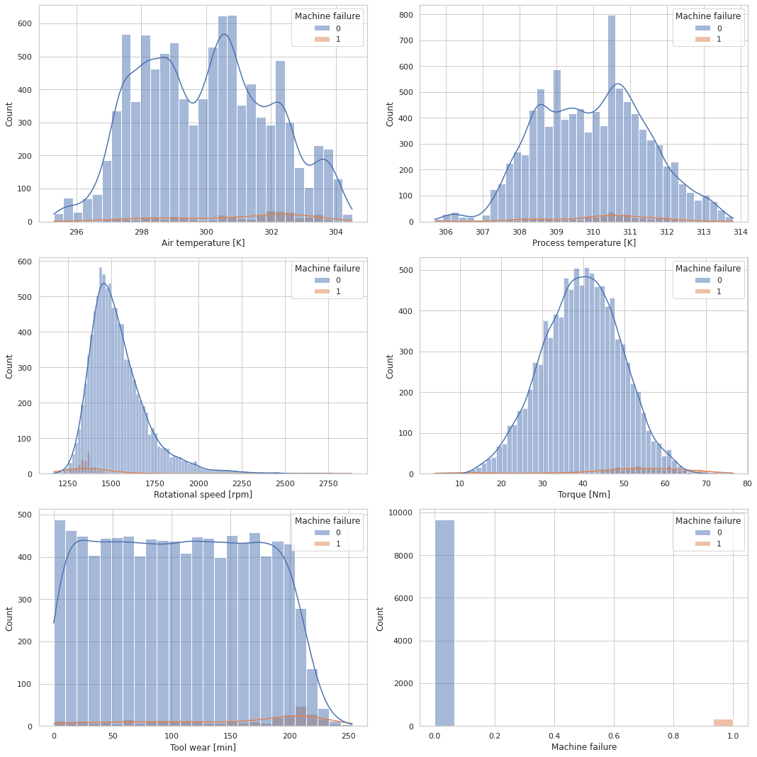
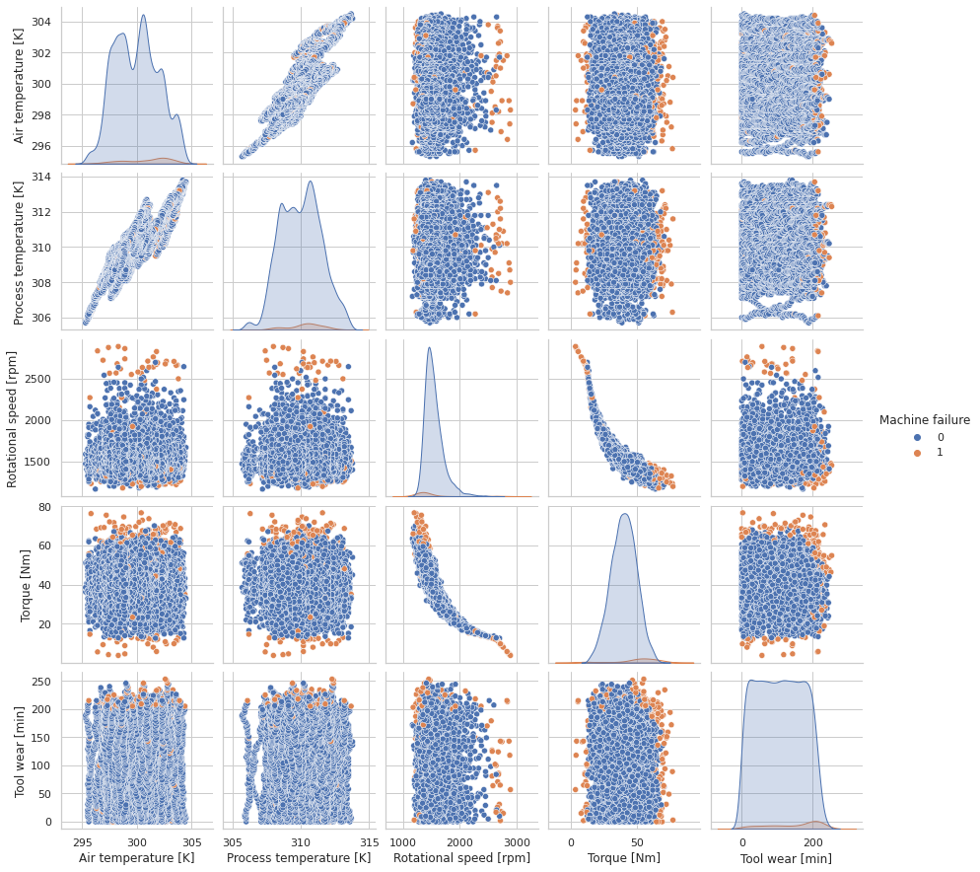
Exploratory Data Analysis (EDA)
Histogram
Pair plot

Slide 8
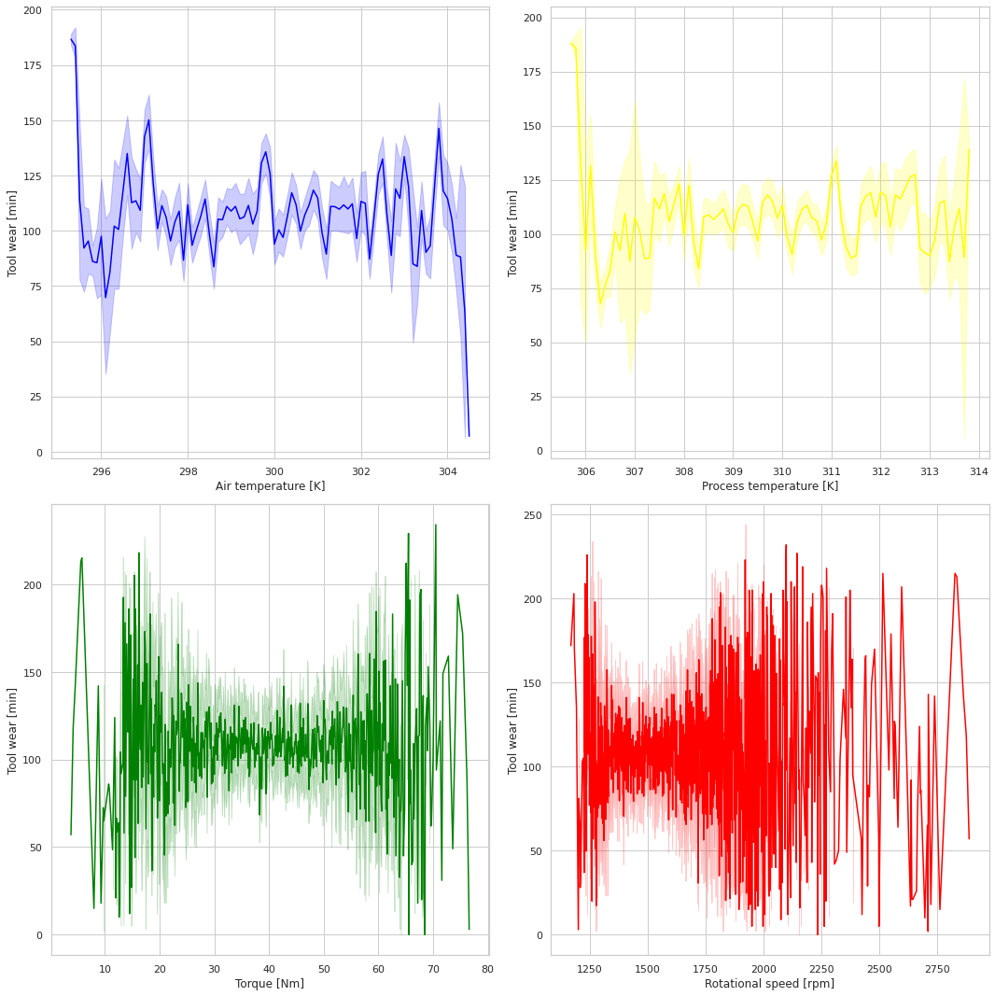
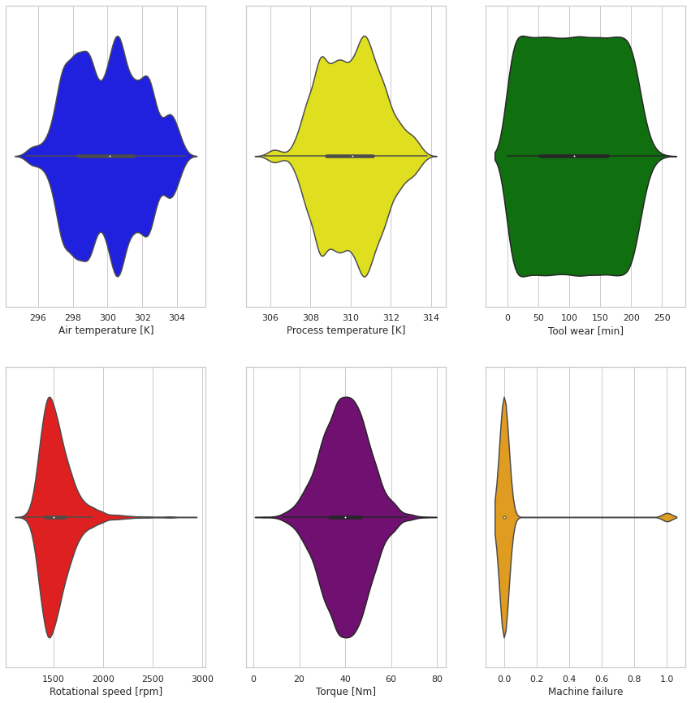
Line Chart
Violin Plot

Slide 9
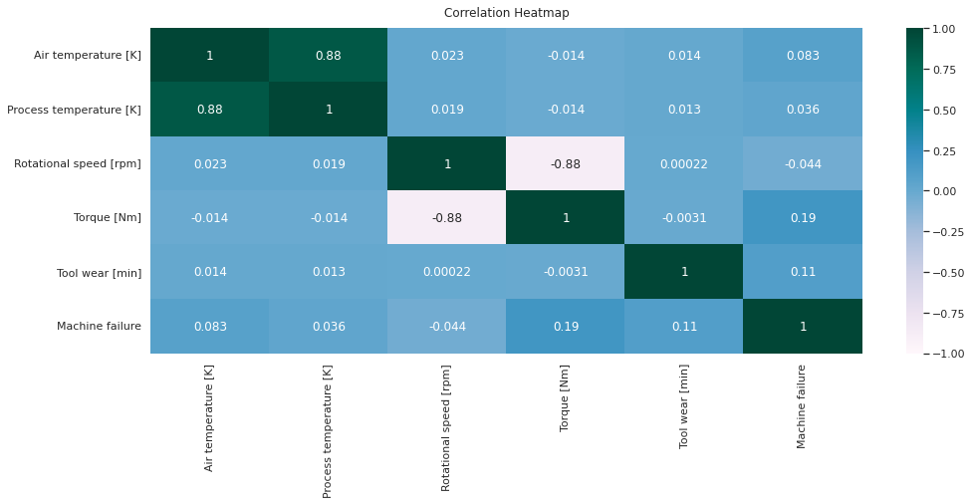
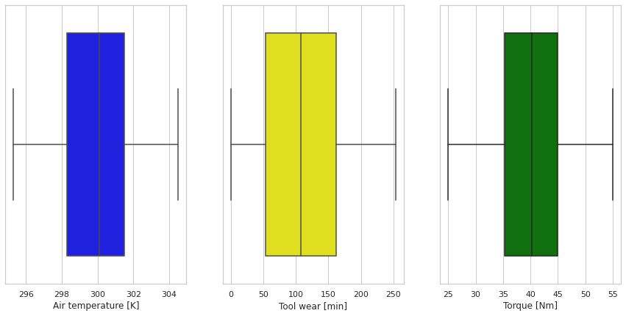
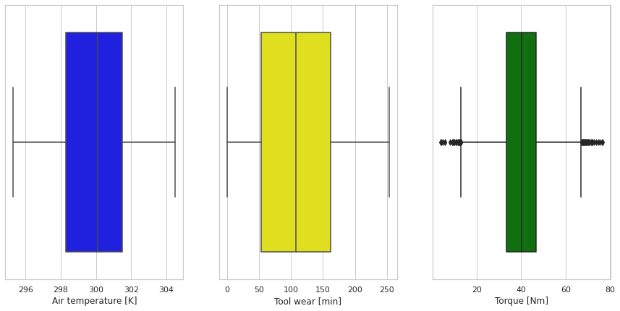
Correlation Heatmap
Side by Side Box-Plot without Outliers
Side by Side Box-Plot with Outliers

Slide 10
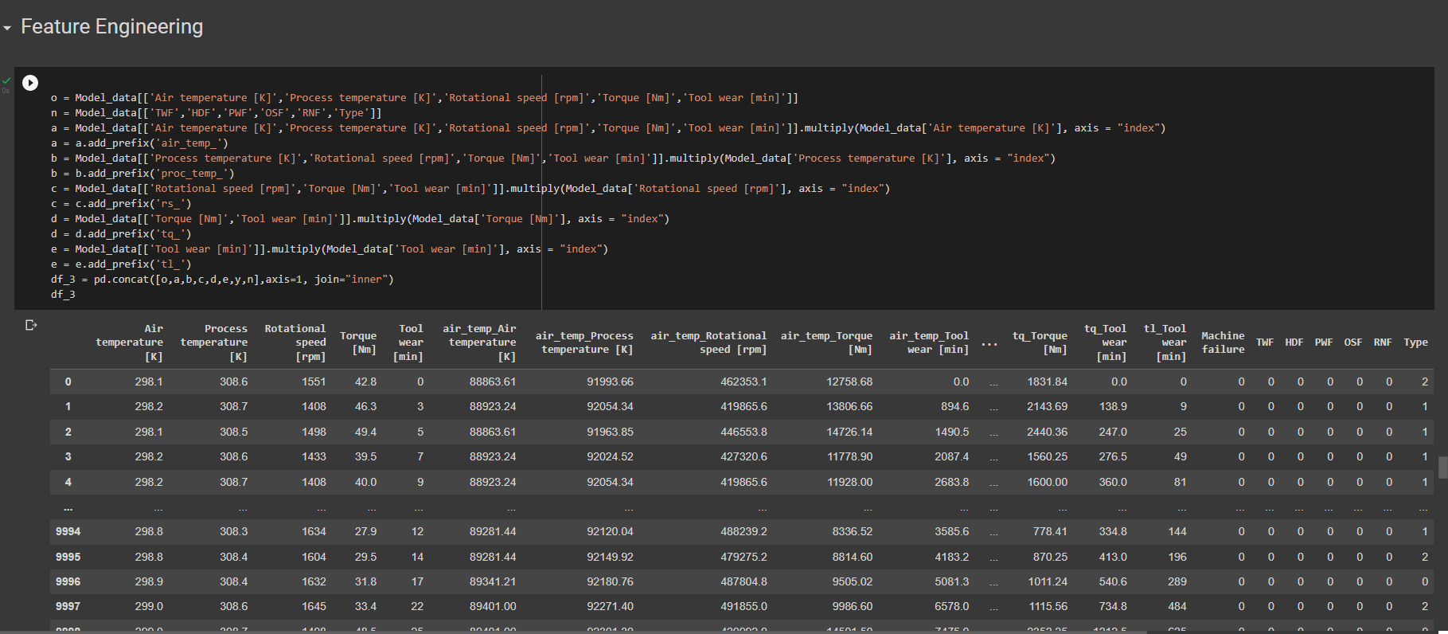
Feature Engineering
Feature engineering is an important step to choose appropriate features in order to effectively train and calibrate algorithms. Feature engineering entails using data mining techniques to extract features from raw data as well as domain knowledge. Feature engineering, which is often referred to as applied machine learning, is useful for improving the performance of machine learning algorithms. As shown in the figure below, we performed a feature engineering step and split the data accordingly.
The feature splitting process allows new features to be clustered and binned, allowing useful information to be extracted and data model performance to be improved. We were able to increase our variables from 14 to 27 after completing this step. That is, we divided the data into 13 columns.

Slide 11
Exploratory Data Analysis (EDA) on Feature Engineered Dataset
After performing PCA, we have decided to remove the most irrelevant features (from both newly added and original features).
We have plotted few significant graphs to interpret the statistical nature of the new generated dataset.
In the following slides, we have added all the visualizations we found useful for this particular dataset:

Slide 12
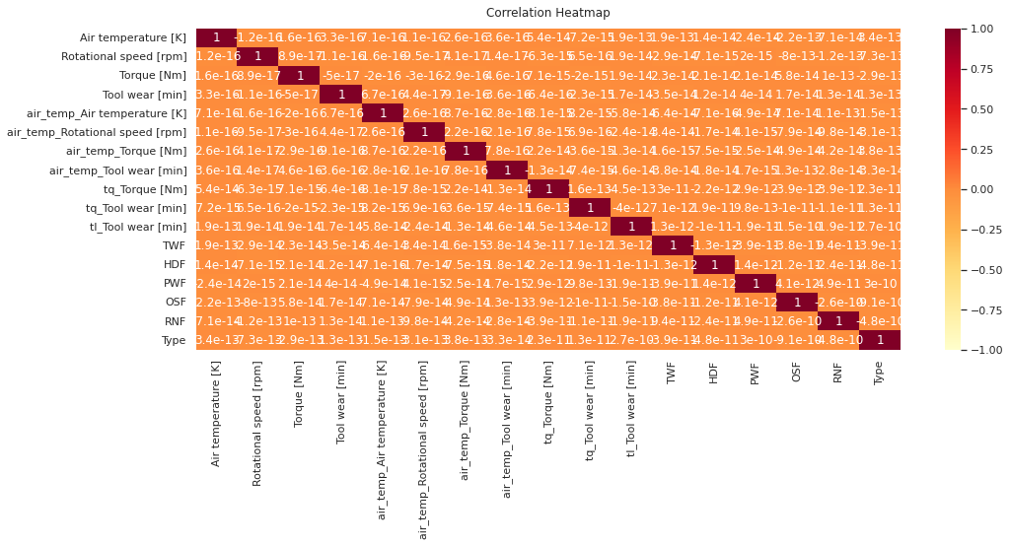
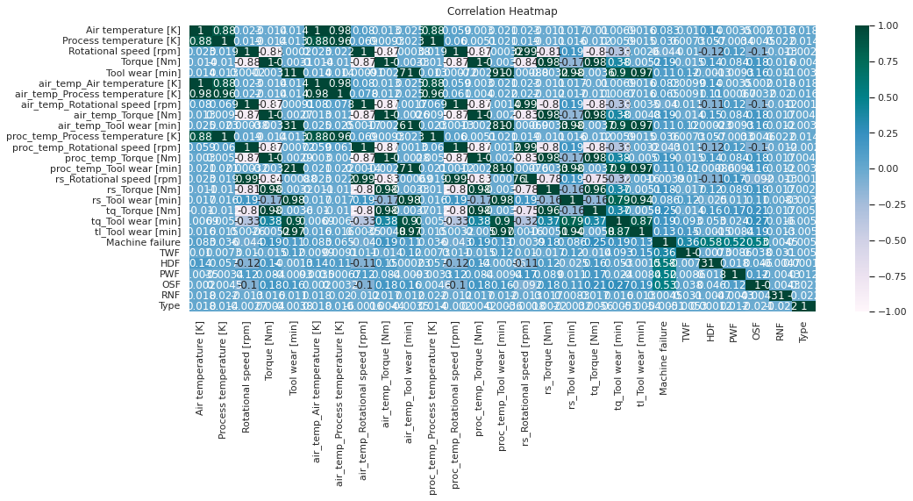
Heat-Map (Before & After Dropping Features)
The first image is the before dropping the highly correlated features and the second image is after we have dropped the highly correlated features

Slide 13
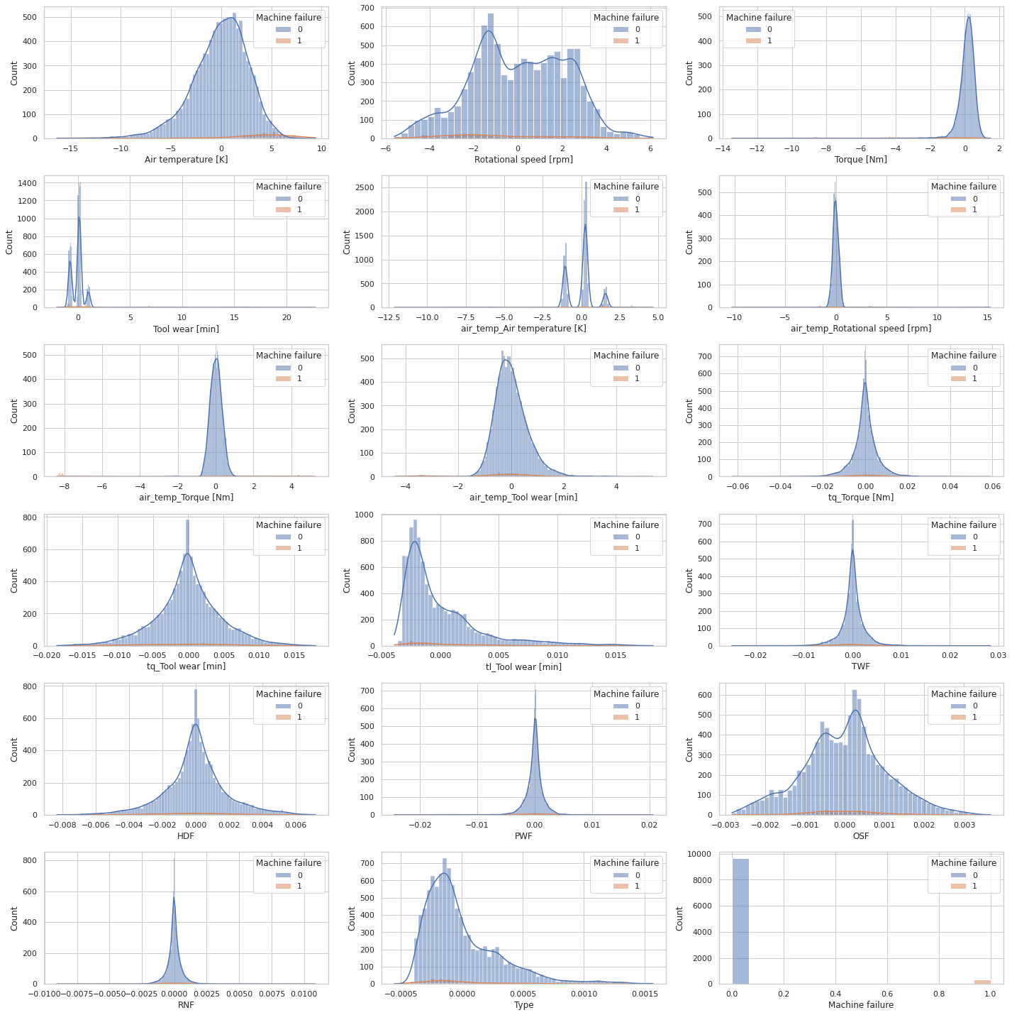
Exploratory Data Analysis (EDA) on Feature Engineered Dataset Histogram:

Slide 14
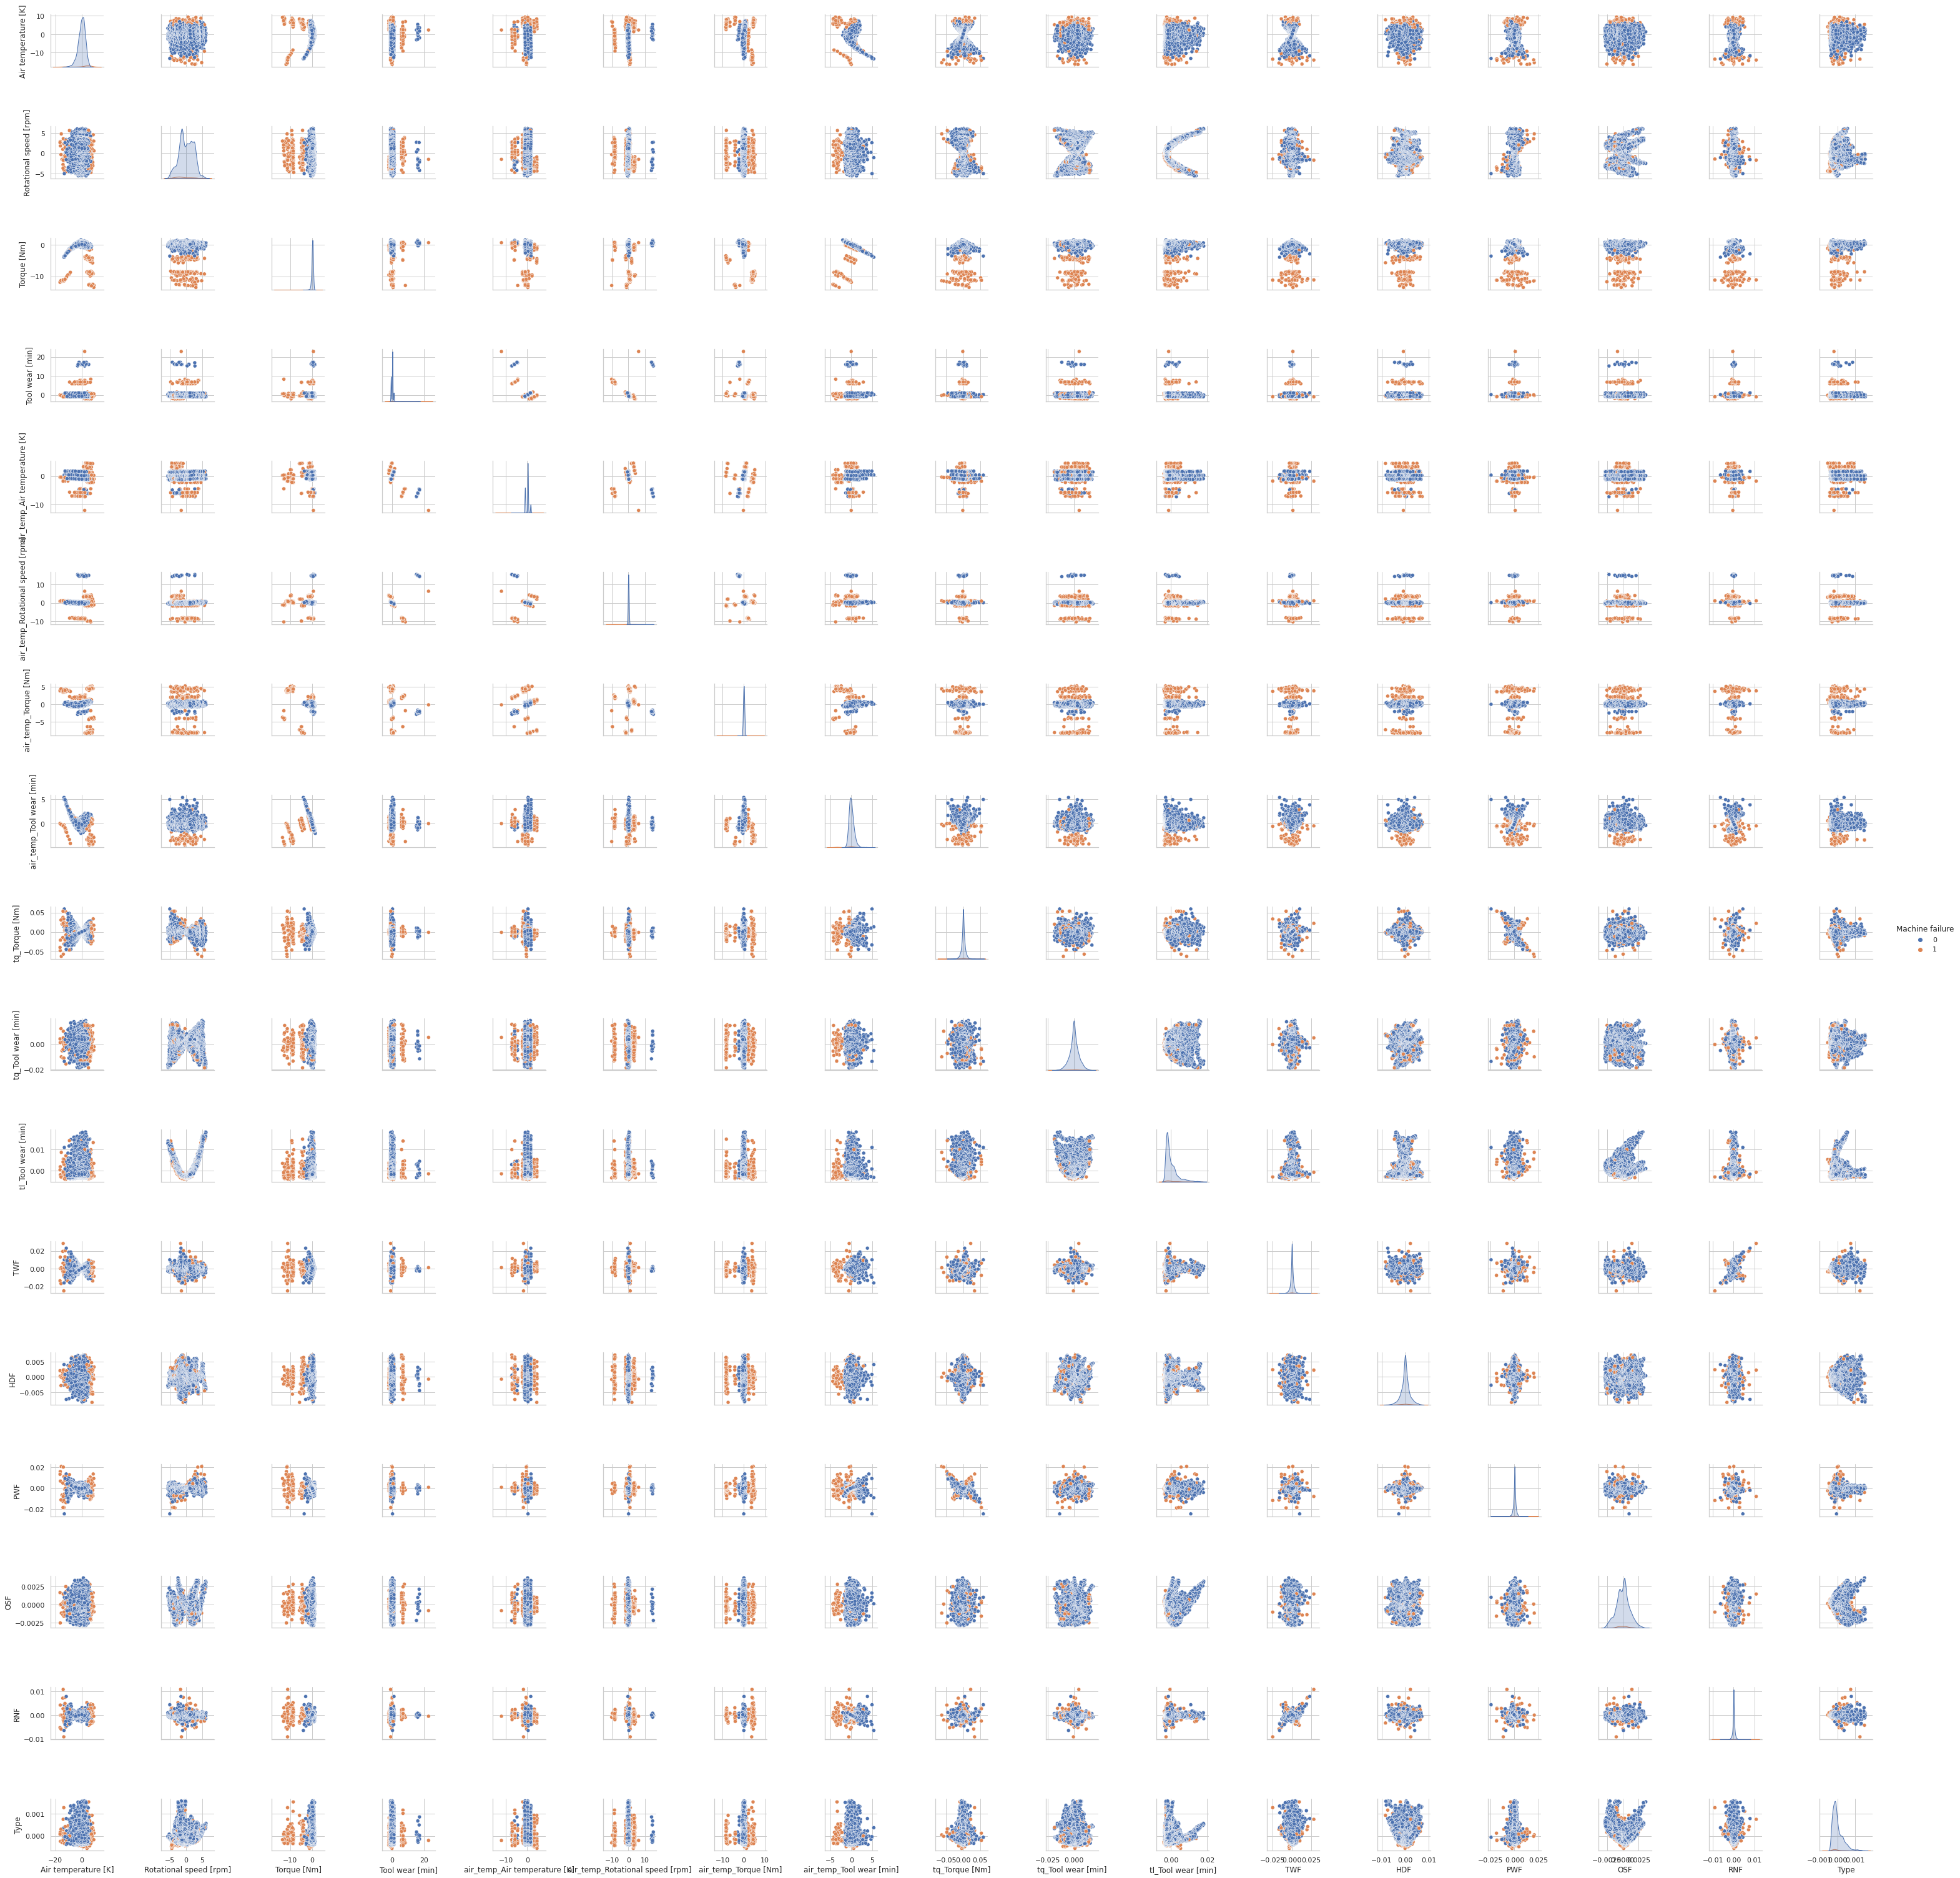
Pair Plot

Slide 15
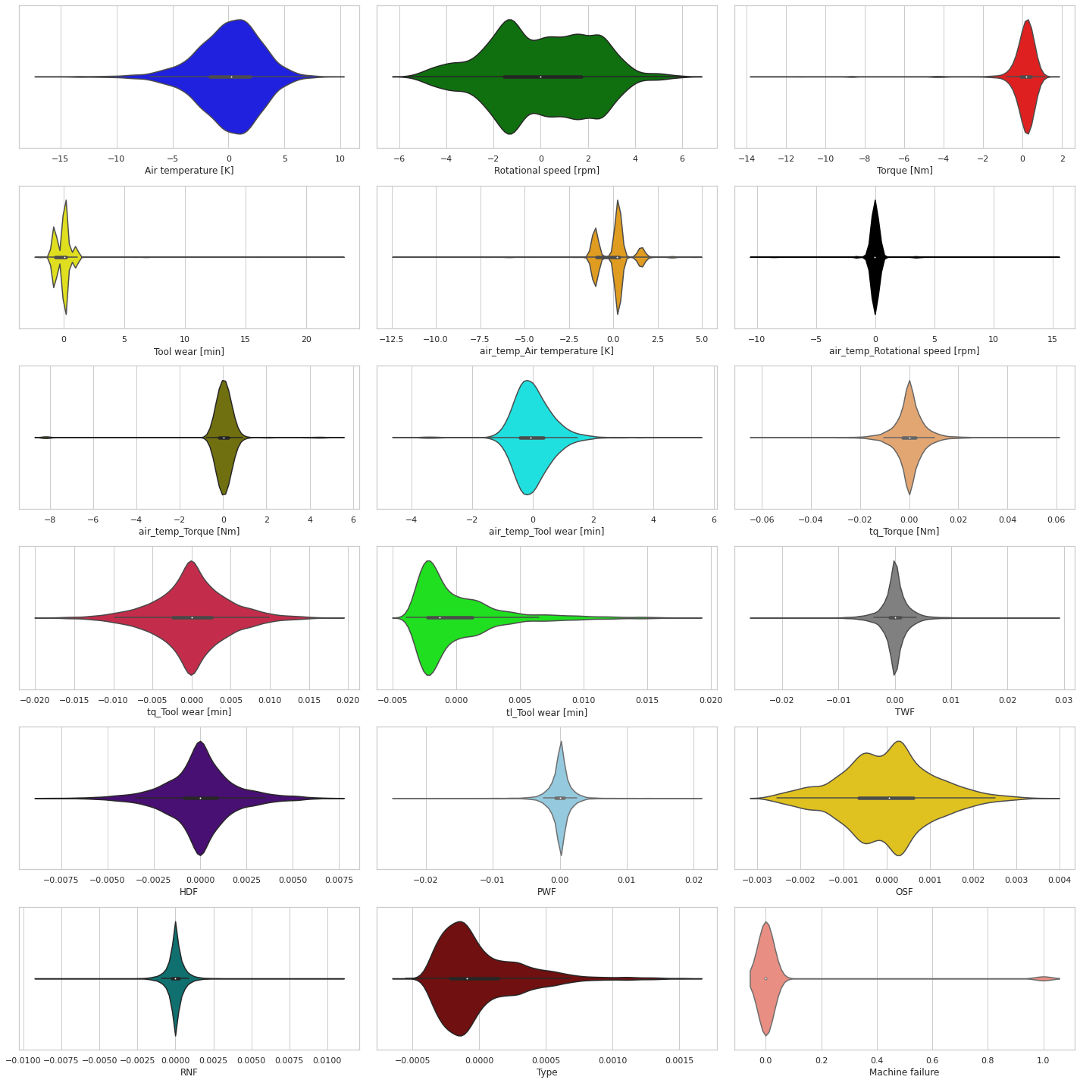
Side – by –Side Violin Plot

Slide 16
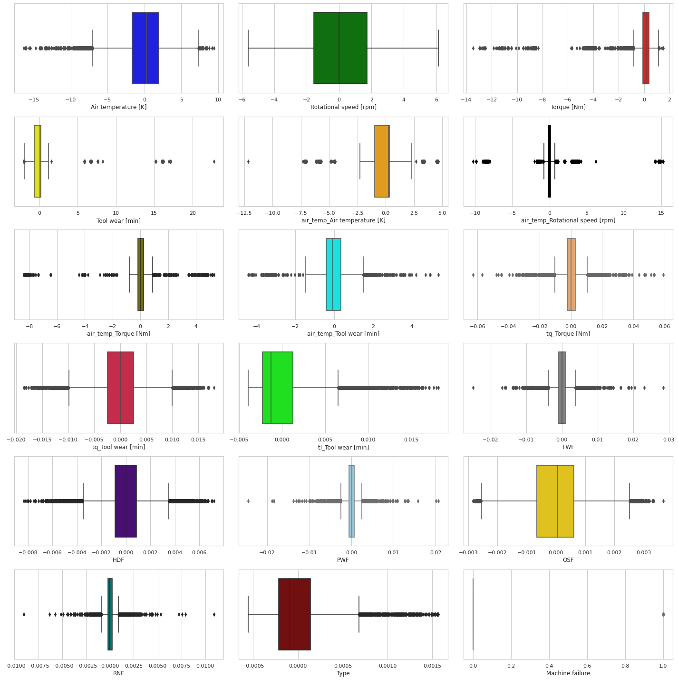
Side – by –Side Box Plot With Outliers

Slide 17
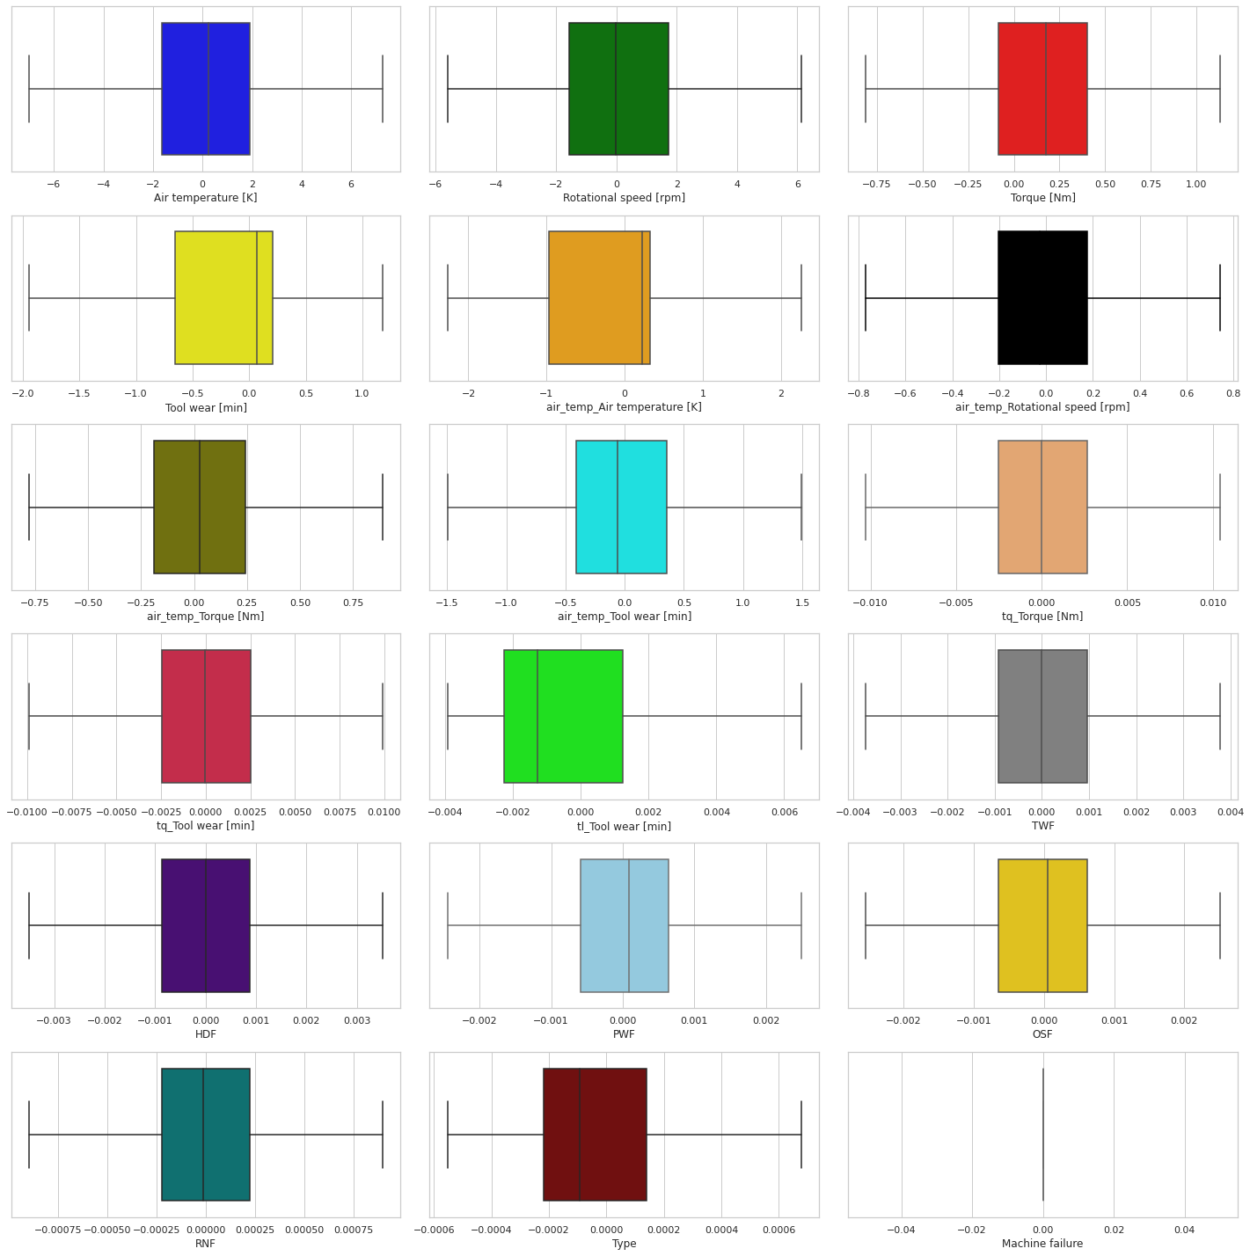
Side – by –Side Box Plot Without Outliers

Slide 18

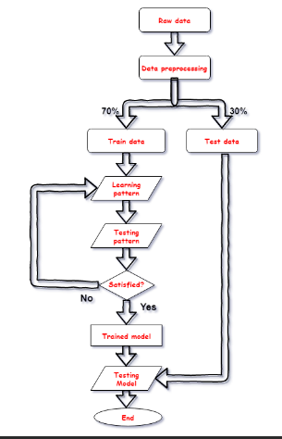
Machine Learning Model Implementation
Using various classification algorithms, we classify if a given machine
Some of the models covered in our curriculum which are used for Classification are as follows:
1) Logistic Regression
2) Naive Bayes
3) Support Vector Machine (SVM)
4) Decision Tree classifier

Slide 19
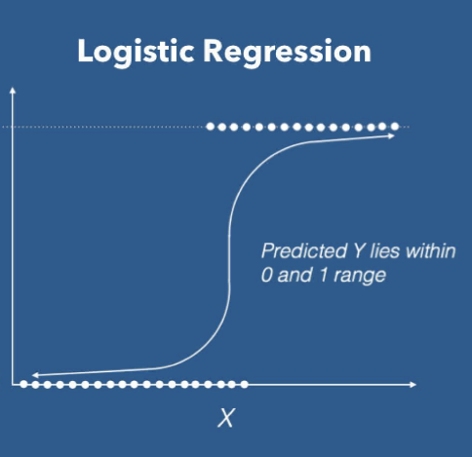
Logistic Regression
Binary classification in a logistic regression uses the Sigmoid function as the Cost function.
S= 1/(1+e^(-t))
Similarly for multiclass Classification a SoftMax function is used.
Logistic regression is easier to implement, and interpret, and very efficient to train.

Slide 20
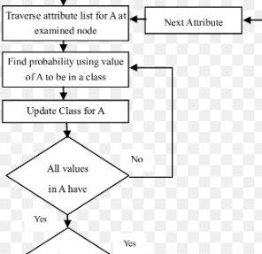
Naïve Bayes Classifier
It is a simple model widely used due to its speed and faster learning rate. Bayes Theorem helps us calculate Probability of A happening provided B has occurred with an assumption that all the features are independent of each other.
The following formulas is used to calculate probability and other metrics which are used to evaluate the model performance :-
P(Class|Data)= (P(Data|Class)*P(Class)) / P(Data)
Precision= True positive/(True Positive+ False Positive)
Recall= True positive/(True Positive +false Negative)
A limitation of naïve Bayes is that, as the features are independent, if an individual likelihood is 0, the entire probability becomes 0.
To avoid this problem, the concept of Laplace Smoothing is used, wherein the likelihood value is replaced by a constant, which eventually helps in comparing both the class probabilities.

Slide 21
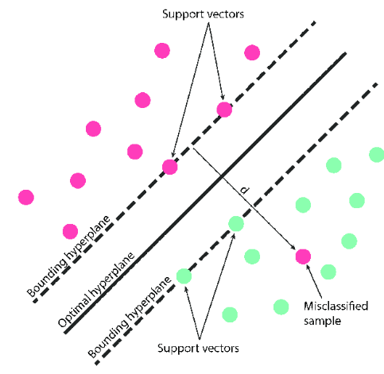
Support vector Machine(SVM)
Out of multiple decision boundaries which separate the classifier, SVM gives us the best decision line which outperforms all other decision lines.
It is a strong classifier and expensive as well, which separates the two classes from one another by maximizing the worst margin.
The following are the types of SVM:-
1) Hard Margin SVM (No misclassification of points is allowed)
2) Soft Margin SVM (Allows some points to misclassify)
3) Kernel SVM (For data that does not exist in linear space)
Deciding which SVM to apply also largely depends on the type of data we are dealing with.

Slide 22
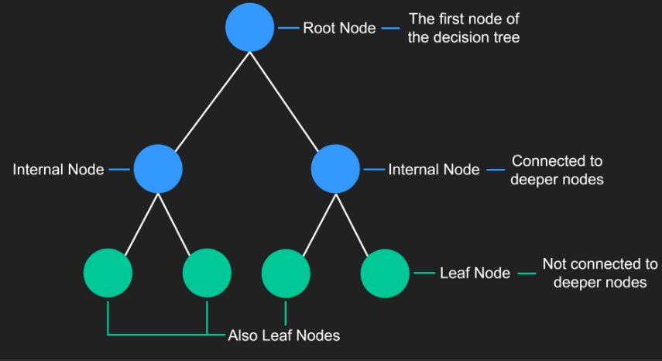
Decision Tree Classifier
Decision Tree classifiers are supervised machine learning models that use prelabelled data to make predictions.
The Decision Tree follows an algorithm based on if-else-then loop.
Each node of a decision tree represents a decision point that splits into two leaf nodes. Each of these nodes represents the outcome of the decision and each of the decisions can also turn into decision nodes.
Eventually, the different decisions will lead to a final classification.

Slide 23
Results
 | Logistic Regression | Gaussian Naïve Bayes | SVM | Decision Tree
Precision | 1 | 0.10 | 0.61 | 0.7
Recall | 0.98 | 0.55 | 0.63 | 0.40
F1 Score | 0.99 | 0.82 | 0.61 | 0.51

Slide 24
Conclusion
It is possible to have a successful predictive/preventive/corrective maintenance program. From a cost reduction view-point, it is essential, but it does entail risk. When the proper care is taken, the risks, however, can be minimized. In order to minimize risk, predictive maintenance has to be carefully planned and carried out by well-trained and motivated workers. The biggest benefits of a PM program occur through painting, lubrication, cleaning and adjusting, and minor component replacement to extend the life of equipment and facilities at small shops or at the industrial level.
Predictive Maintenance allows for safety compliance, preemptive corrective actions, and increased asset life. By looking ahead, and knowing what failure is likely to occur when, pre-emptive investigations, maintenance schedule adjustments, and repairs can be performed before the asset fails
It will ultimately aid in the lifespan of machines and the cost of maintaining them at different period of times

Slide 25
Thank you

